Slide 1

Linear Algebra for Machine Learning: Fundamentals of Linear Algebra
Mina Farmanbar
Associate Professor, University of Stavanger
for engineers

Slide 2




Linear Algebra
Linear Algebra
Data Representation
Vector Embedding
Dimensionality Reduction

Slide 3
Linear algebra for Machine Learning
Linear algebra plays a key foundation in machine learning (ML), and it enables ML algorithms to run on a huge number of datasets.
Linear Algebra helps to create better supervised as well as unsupervised Machine Learning algorithms.

Slide 4
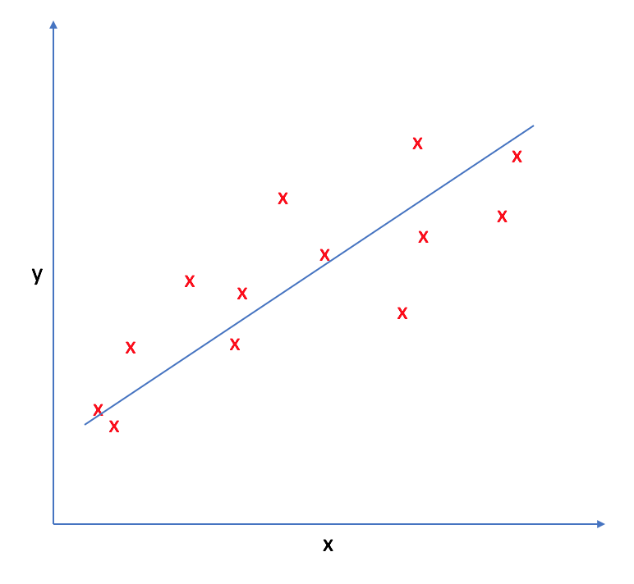
Creating better Machine Learning algorithms
Some of the supervised learning algorithms that can be created using Linear Algebra:
Linear Regression (RL)
https://www.jeremyjordan.me/linear-regression/

Slide 5
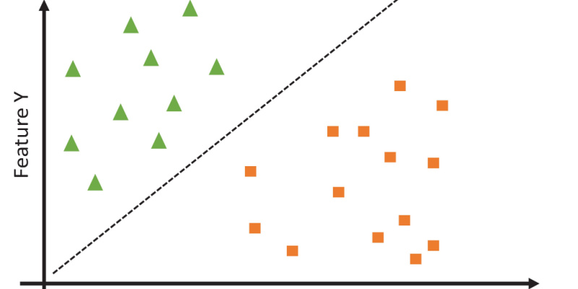
Creating better Machine Learning algorithms
https://www.spiceworks.com/tech/big-data/articles/what-is-support-vector-machine/
Support Vector Machines (SVM)

Slide 6
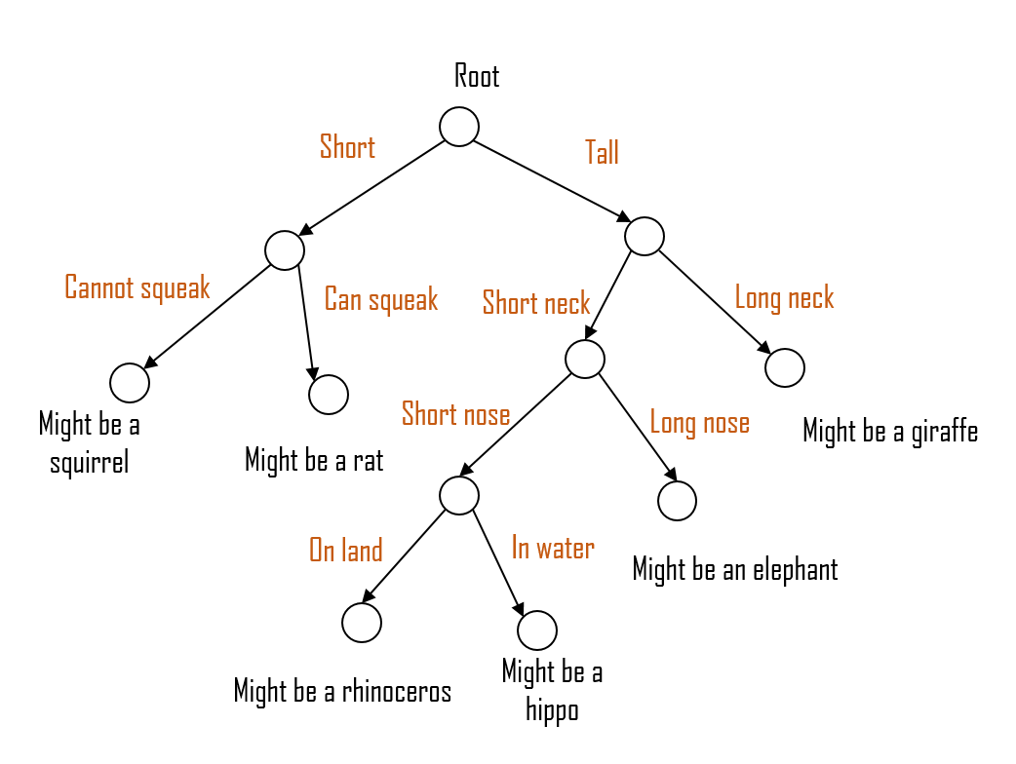
Creating better Machine Learning algorithms
Decision Trees (DT)
https://miro.medium.com/v2/resize:fit:1400/format:webp/1*ER9uqmxlsLue-o3eUyMpHA.png

Slide 7
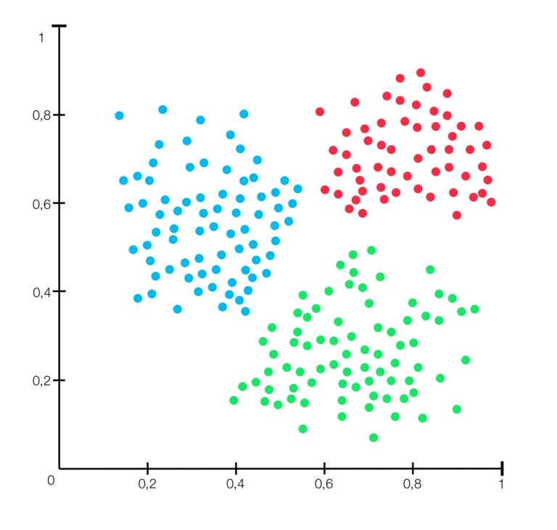
Creating better Machine Learning algorithms
Further, below are some unsupervised learning algorithms listed that can also be created with the help of linear algebra:
Clustering
https://rocketloop.de/en/blog/clustering-machine-learning-comprehensive-guide/

Slide 8
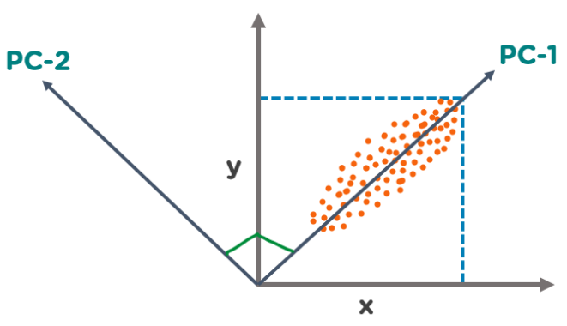
Creating better Machine Learning algorithms
Principal Component Analysis (PCA)
https://www.simplilearn.com/tutorials/machine-learning-tutorial/principal-component-analysis
With the help of Linear Algebra concepts, you can also self-customize the various parameters in the live project and understand in-depth knowledge to deliver the same with more accuracy and precision.

Slide 9
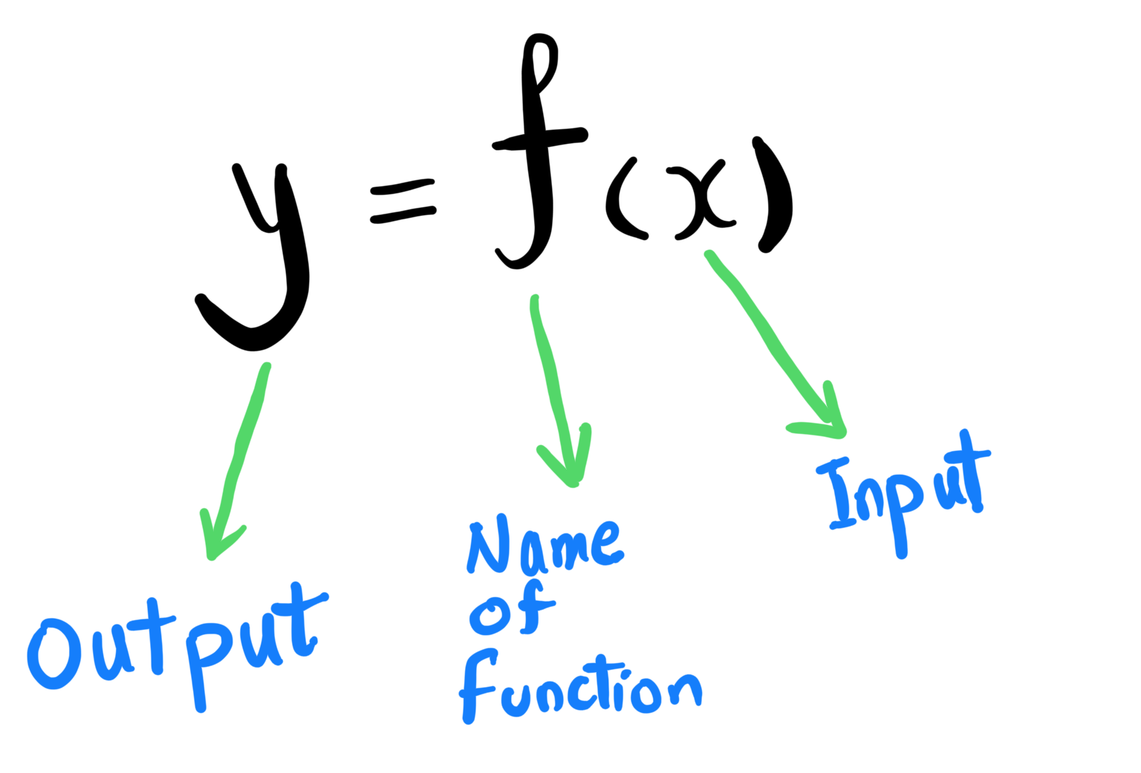
Functions
Functions are something that convert a given set of inputs to a given set of outputs.

Slide 10
Functions
What could we use the function for?
A function is used to model the relation between different quantities.
For example:
The amount of rainfall a region receives and its agricultural output.
The profit of a company and the amount it spends on marketing.

Slide 11

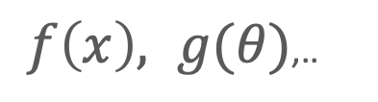

Functions
Input
Relationship
Output
$$f, g, h,..$$
$$x, t, θ,..$$
$f\left(x\right), g(θ)$,..
Domain
Domain Elements
Independent Variable
Argument
Range Image
Range elements
Dependent Variable
Value of Function
maps to

Slide 12

Functions
Let’s say we want to find the relationship between the price of a car and the power of its engine.
We know that price depends upon the power.
AI generetaed, DALEE 2, 2024

Slide 13
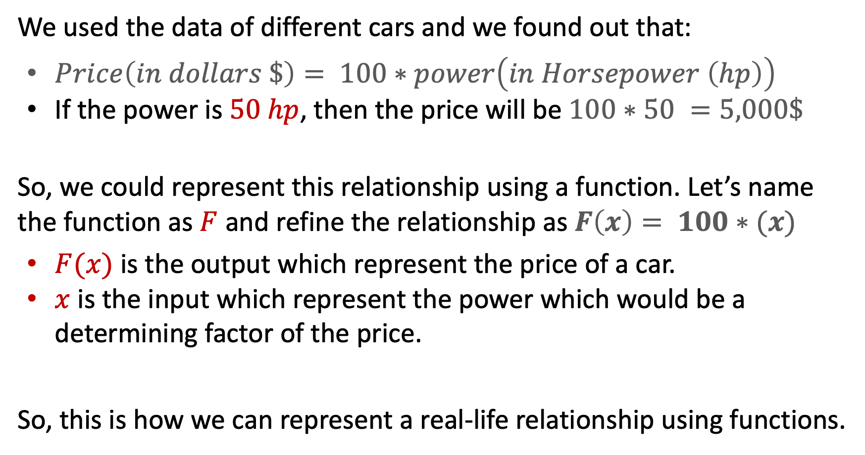
Functions
We used the data of different cars and we found out that:
$Price\left(in dollars \$\right)= 100∗power\left(in Horsepower \left(hp\right)\right)$
If the power is $50 hp$, then the price will be $100∗50 =5,000\$$
So, we could represent this relationship using a function. Let’s name the function as $F$ and refine the relationship as $F\left(x\right)= 100∗(x)$
$F(x)$ is the output which represent the price of a car.
$x$ is the input which represent the power which would be a determining factor of the price.
So, this is how we can represent a real-life relationship using functions.

Slide 14
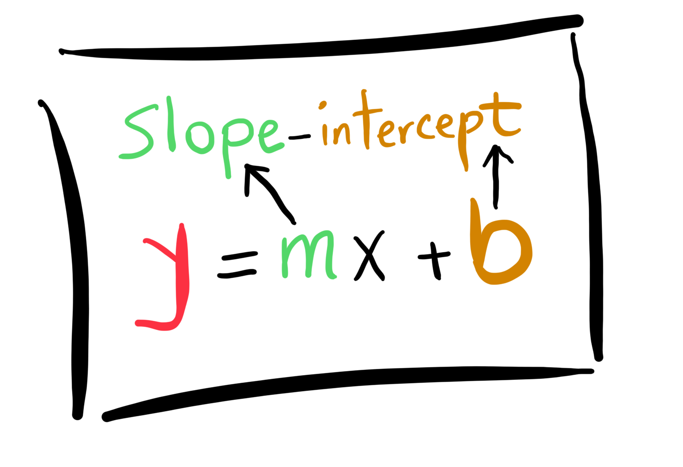
Equation of a line
The equation of a line in a two-dimensional coordinate system can be expressed in several different forms, each useful for different purposes. Here is the most common form:

Slide 15
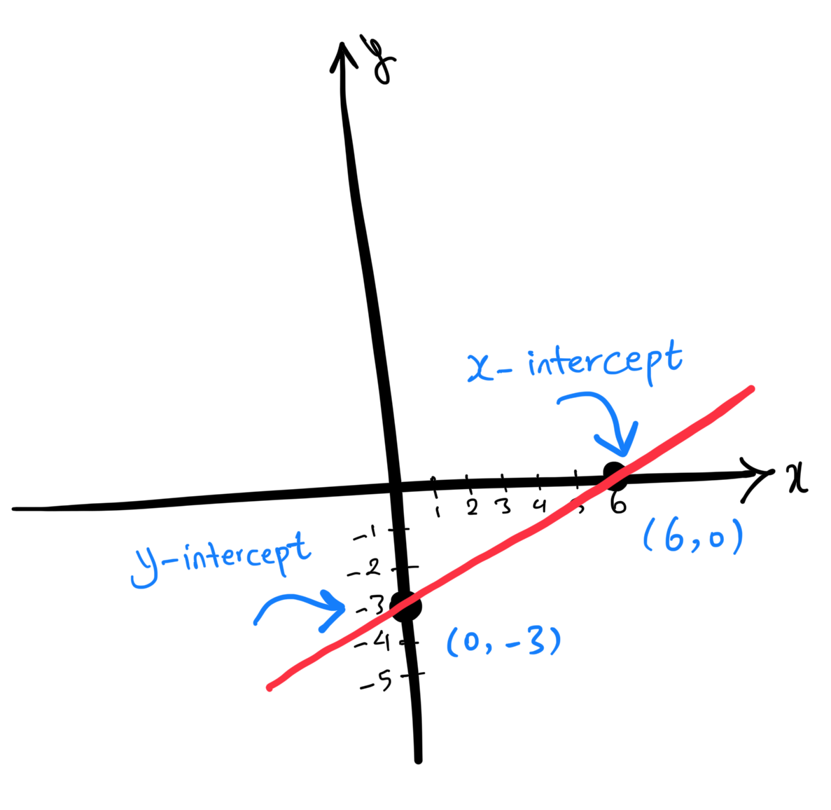
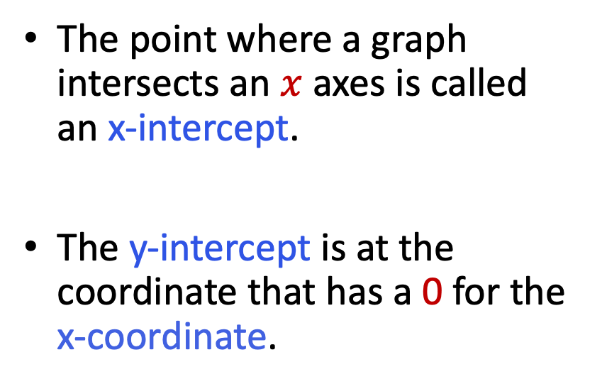
Equation of a line
The point where a graph intersects an $x$ axes is called an x-intercept.
The y-intercept is at the coordinate that has a 0 for the x-coordinate.

Slide 16
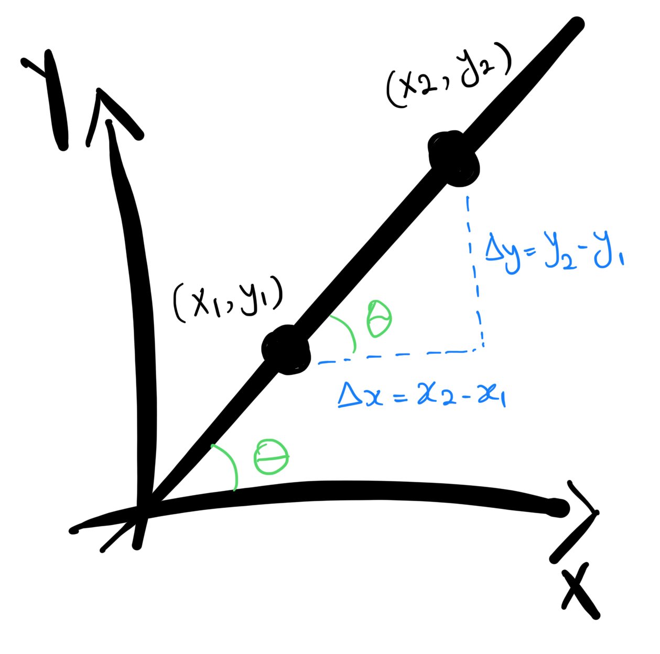
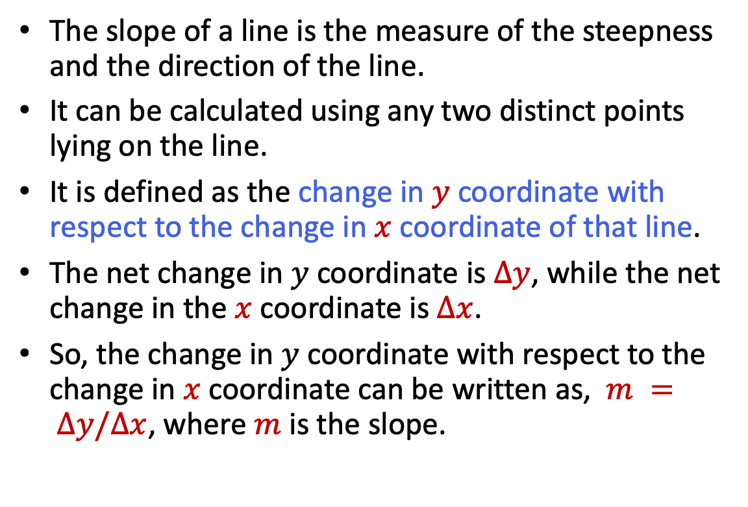
Slope
The slope of a line is the measure of the steepness and the direction of the line.
It can be calculated using any two distinct points lying on the line.
It is defined as the change in $y$ coordinate with respect to the change in $x$ coordinate of that line.
The net change in $y$ coordinate is $Δy$, while the net change in the $x$ coordinate is $Δx$.
So, the change in $y$ coordinate with respect to the change in $x$ coordinate can be written as, $m = Δy/Δx$, where $m$ is the slope.

Slide 17
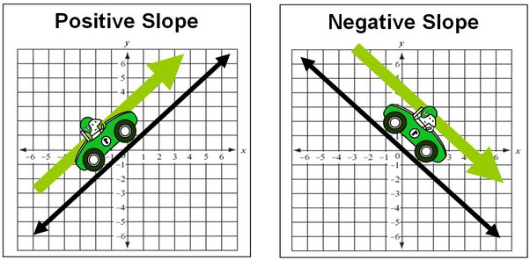
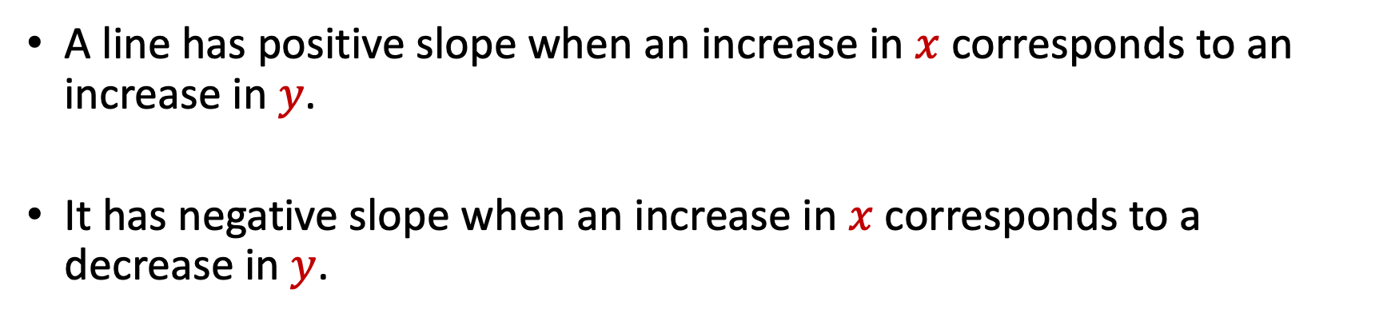
Slope
A line has positive slope when an increase in $x$corresponds to an increase in $y$.
It has negative slope when an increase in $x$corresponds to a decrease in $y$.
https://www.quia.com/pages/msemath/page4

Slide 18
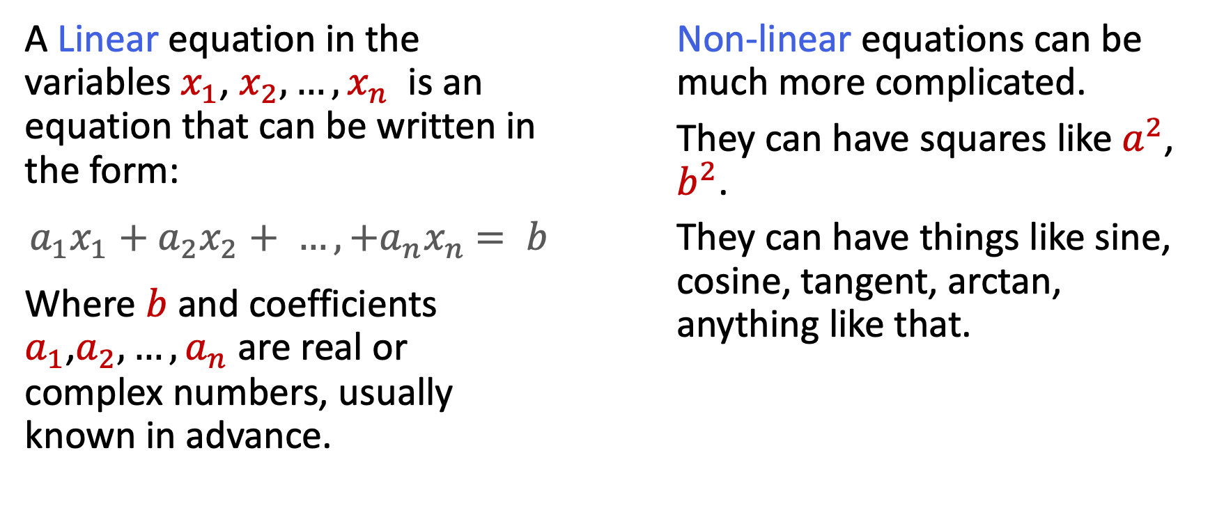
Linear Equation Vs. Non-Linear Equation
A Linear equation in the variables $x_{1}$, $x_{2},{…, x}_{n}$ is an equation that can be written in the form:
$a_{1}x_{1}+$ ${a_{2}x}_{2}+ {…, +a_{n}x}_{n}$ $= b$
Where $b$ and coefficients $a_{1}$,$a_{2},…,a_{n}$ are real or complex numbers, usually known in advance.
Non-linear equations can be much more complicated.
They can have squares like $a^{2}$, $b^{2}$.
They can have things like sine, cosine, tangent, arctan, anything like that.

Slide 19

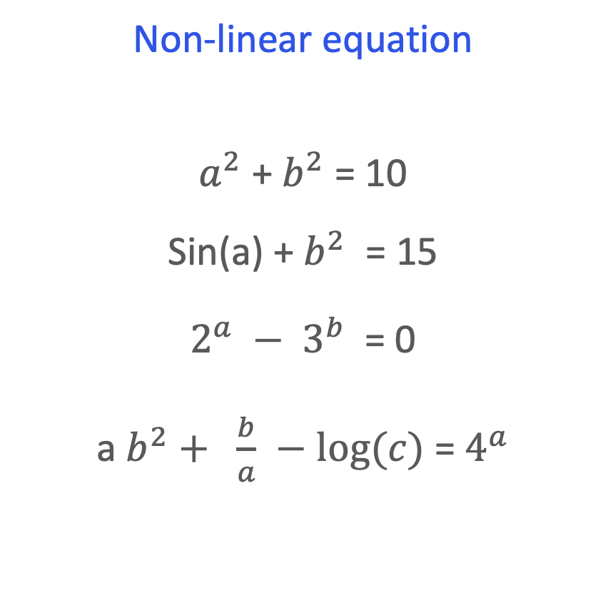
Linear Equation Vs. Non-Linear Equation
Linear equation
$$a + b = 10$$
$$2a + 3b = 15$$
$$3.4a – 48.25b + 2c = 122.5$$
Non-linear equation
$a^{2}$ + $b^{2}$ = 10
Sin(a) + $b^{2}$ = 15
$2^{a} − 3^{b}$ = 0
a $b^{2}+ \frac{b}{a}$ $−$ $log⁡(c)$ = $4^{a}$

Slide 20
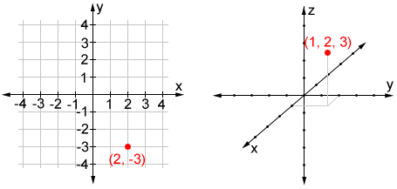
Linear equations
A linear equation can exist in any number of dimensions. The concept of a linear equation can be generalized from 2 dimensions (a line) to higher dimensions such as 3 dimensions (a plane), 4 dimensions, and beyond.

Slide 21
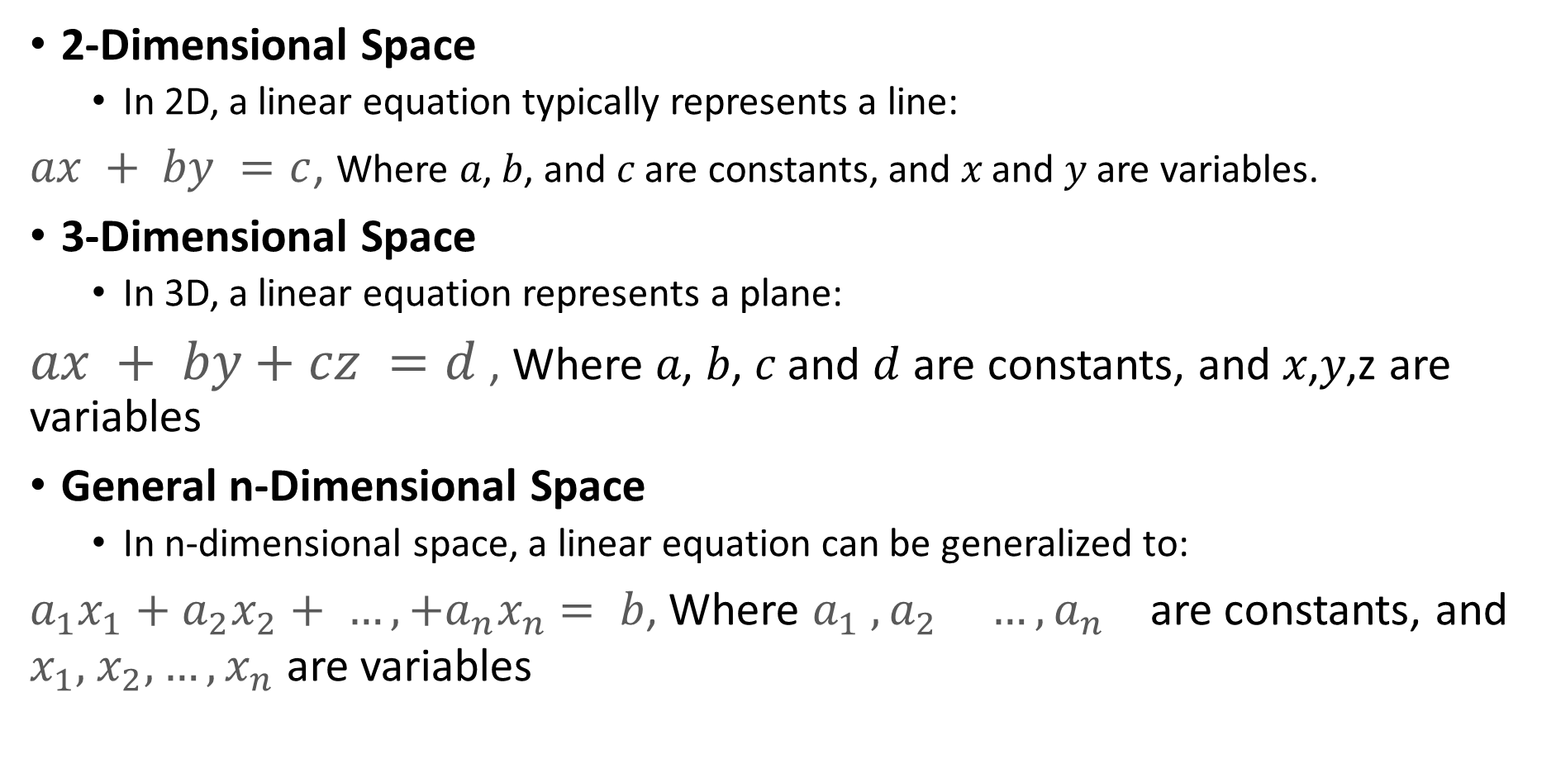
Linear equations
2-Dimensional Space
In 2D, a linear equation typically represents a line:
$ax + by =c$, Where 𝑎, 𝑏, and 𝑐 are constants, and 𝑥 and 𝑦 are variables.
3-Dimensional Space
In 3D, a linear equation represents a plane:
$ax + by+cz =d$ , Where 𝑎, 𝑏, 𝑐 and $d$ are constants, and 𝑥,𝑦,z are variables
General n-Dimensional Space
In n-dimensional space, a linear equation can be generalized to:
$a_{1}x_{1}+$ ${a_{2}x}_{2}+ {…, +a_{n}x}_{n}$ $= b$, Where $a_{1}$ $,{a_{2}}_{} {…, a_{n}}_{}$are constants, and $x_{1},$ $x_{2}, {…, x}_{n}$ are variables

Slide 22
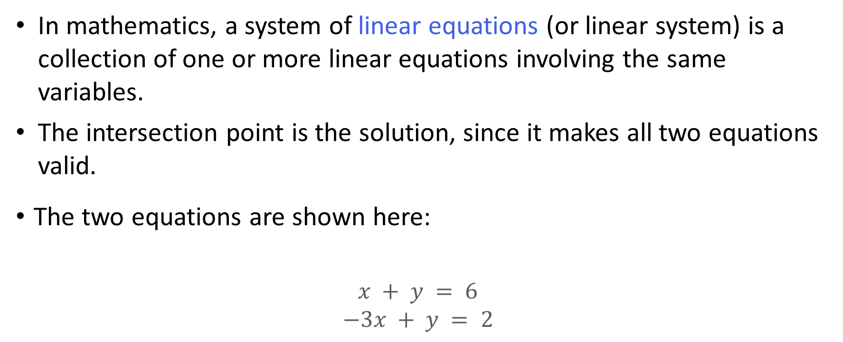
System of Linear equations
In mathematics, a system of linear equations (or linear system) is a collection of one or more linear equations involving the same variables.
The intersection point is the solution, since it makes all two equations valid.
The two equations are shown here:
$$x + y = 6$$
$$−3x + y = 2$$

Slide 23
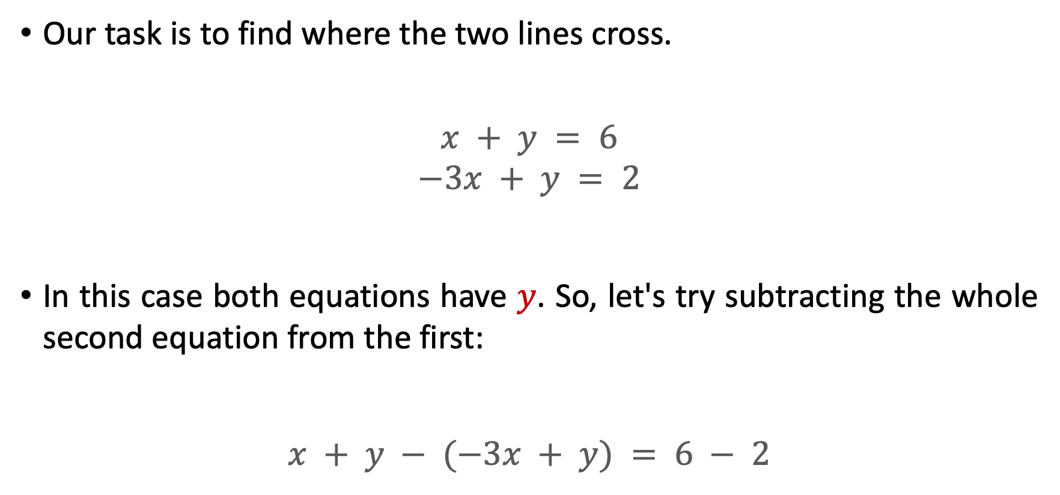
System of Linear equations
Our task is to find where the two lines cross.
$$x + y = 6$$
$$−3x + y = 2$$
In this case both equations have $y$. So, let's try subtracting the whole second equation from the first:
$$x + y − (−3x + y) = 6 − 2$$

Slide 24

System of Linear equations
Now let us simplify it:
$$x + y + 3x − y = 6 − 2$$
$$4x = 4$$
$$x = 1$$
So now we know the lines cross at
$$x=1$$

Slide 25
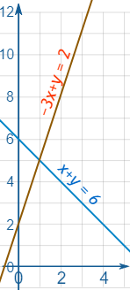
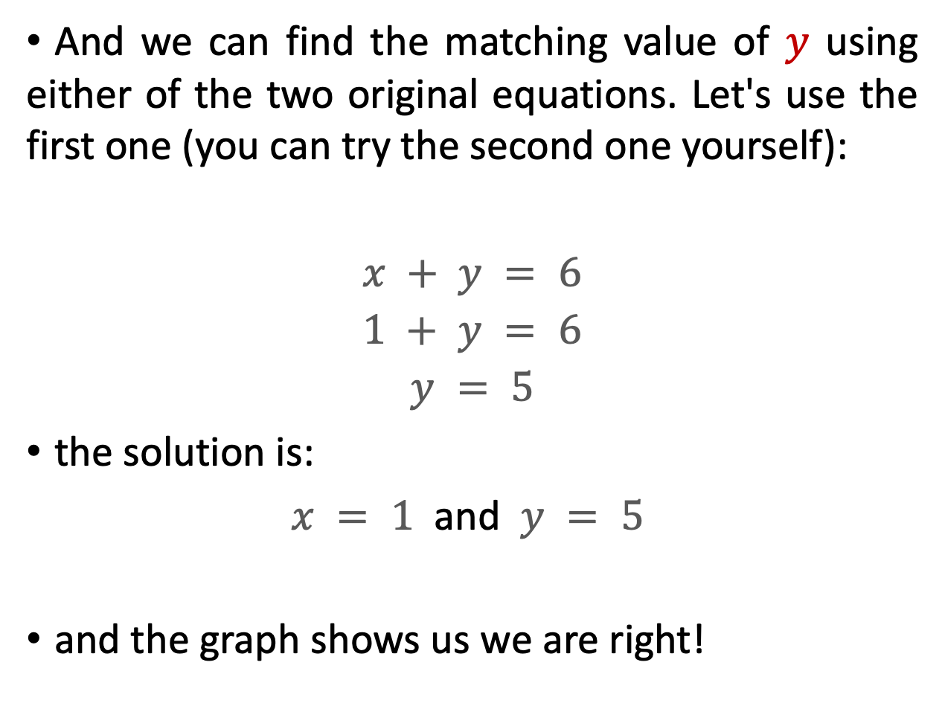
System of Linear equations
And we can find the matching value of $y$ using either of the two original equations. Let's use the first one (you can try the second one yourself):
$$x + y = 6$$
$$1 + y = 6$$
$$y = 5$$
the solution is:
$x = 1$ and $y = 5$
and the graph shows us we are right!
https://www.mathsisfun.com/algebra/images/system-linear-d.svg

Slide 26
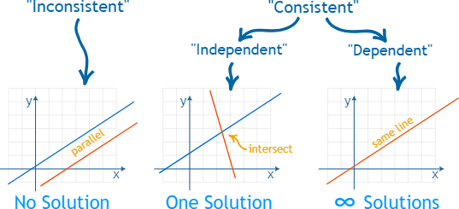
System of Linear equations
When the number of equations is the same as the number of variables there is likely to be a solution.
There are only three possible cases:
No solution
One solution
Infinitely many solutions
When there is:
No solution, the equations are called "inconsistent".
One or infinitely many solutions are called "consistent".

Slide 27
Summary
Linear equations and systems of linear equations form the foundational basis for linear regression in machine learning which is a statistical method used to model the relationship between a dependent variable and one or more independent variables.

Slide 28
Thank you!
Mina Farmanbar​
mina.farmanbar@uis.no

